Slide 1
Chapter 4
Digital Input and Output

Slide 2
Table of Contents
Introduction
Microcontroller Architecture
Software Development Platforms
Digital Input and Output
Interrupts and Power Management
Timing Operations
Conversion Between Analog and Digital Values
Digital Communication
Memory Operations
Real-time Operating Systems
LCD, Touch Screen, and Graphical User Interface Formation
Introduction to Digital Signal Processing
Introduction to Digital Control
Introduction to Digital Image Processing
Advanced Topics

Slide 3
LAYOUT
Introduction
Bit Values as Voltage Levels
Interfacing Voltage Levels with the Microcontroller
  Digital Input from a Switch or Button
  Digital I/O with High Voltage Values
  Digital Output to a Load Requiring High Current and Voltage Values
Digital I/O Setup on the STM32F4 Microcontroller
  Circuit Diagram of a Pin and Its Setup via Associated Registers
  GPIO Registers in Memory Map of the STM32F4 Microcontroller
  Setting Up GPIO Registers
Digital I/O Usage on the STM32F4 Microcontroller
  C Language Usage
  C++ Language Usage
  MicroPython Usage

Slide 4
Introduction
The microcontroller should interact with the outside world.
To do so, we will introduce interfacing digital input and output (digital I/O) to and from the microcontroller in this chapter.
Peripheral units dedicated for this operation are called general purpose input and output (GPIO) pins.
These will form a bridge between code-based bit values (logic level 0 or 1) and voltage levels to be fed or received from the outside world.
We will show how the logic level 0 or 1 can be represented in voltage level.
We will deal with interfacing these voltage levels with the microcontroller.
We will focus on digital I/O setup within the STM32F4 microcontroller followed by its usage.

Slide 5
Bit Values as Voltage Levels
If we start interacting the microcontroller with the outside world, then abstract representations such as logic level 0 or 1 do not mean much.
We should associate these logic levels with actual voltage values used in the microcontroller

Slide 6
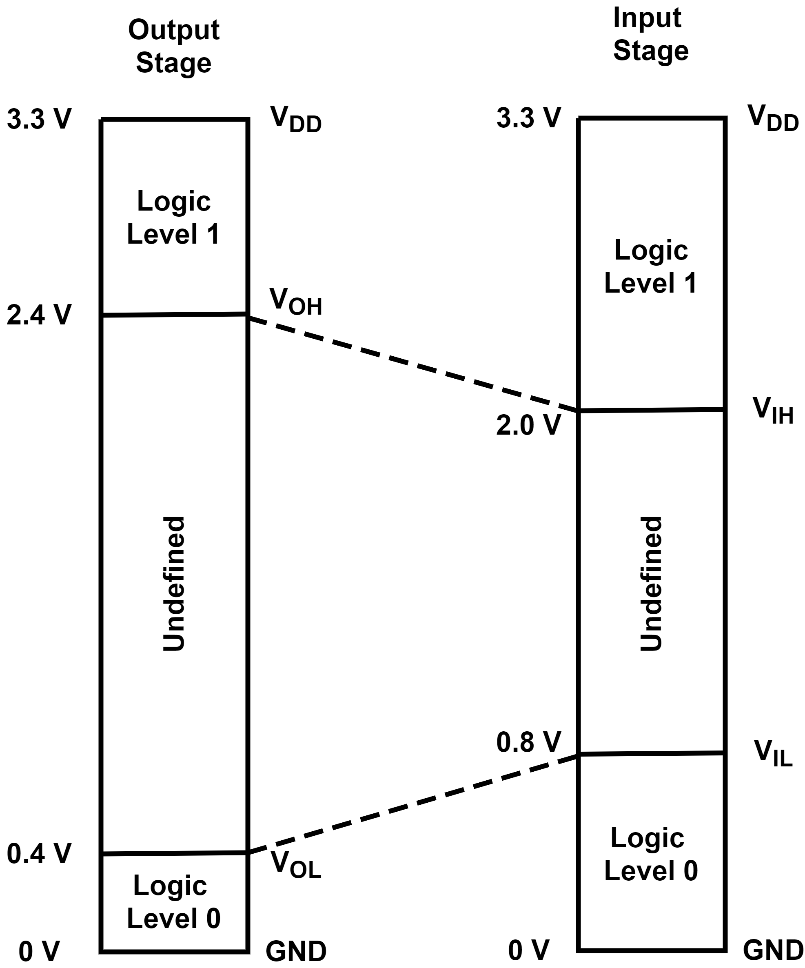
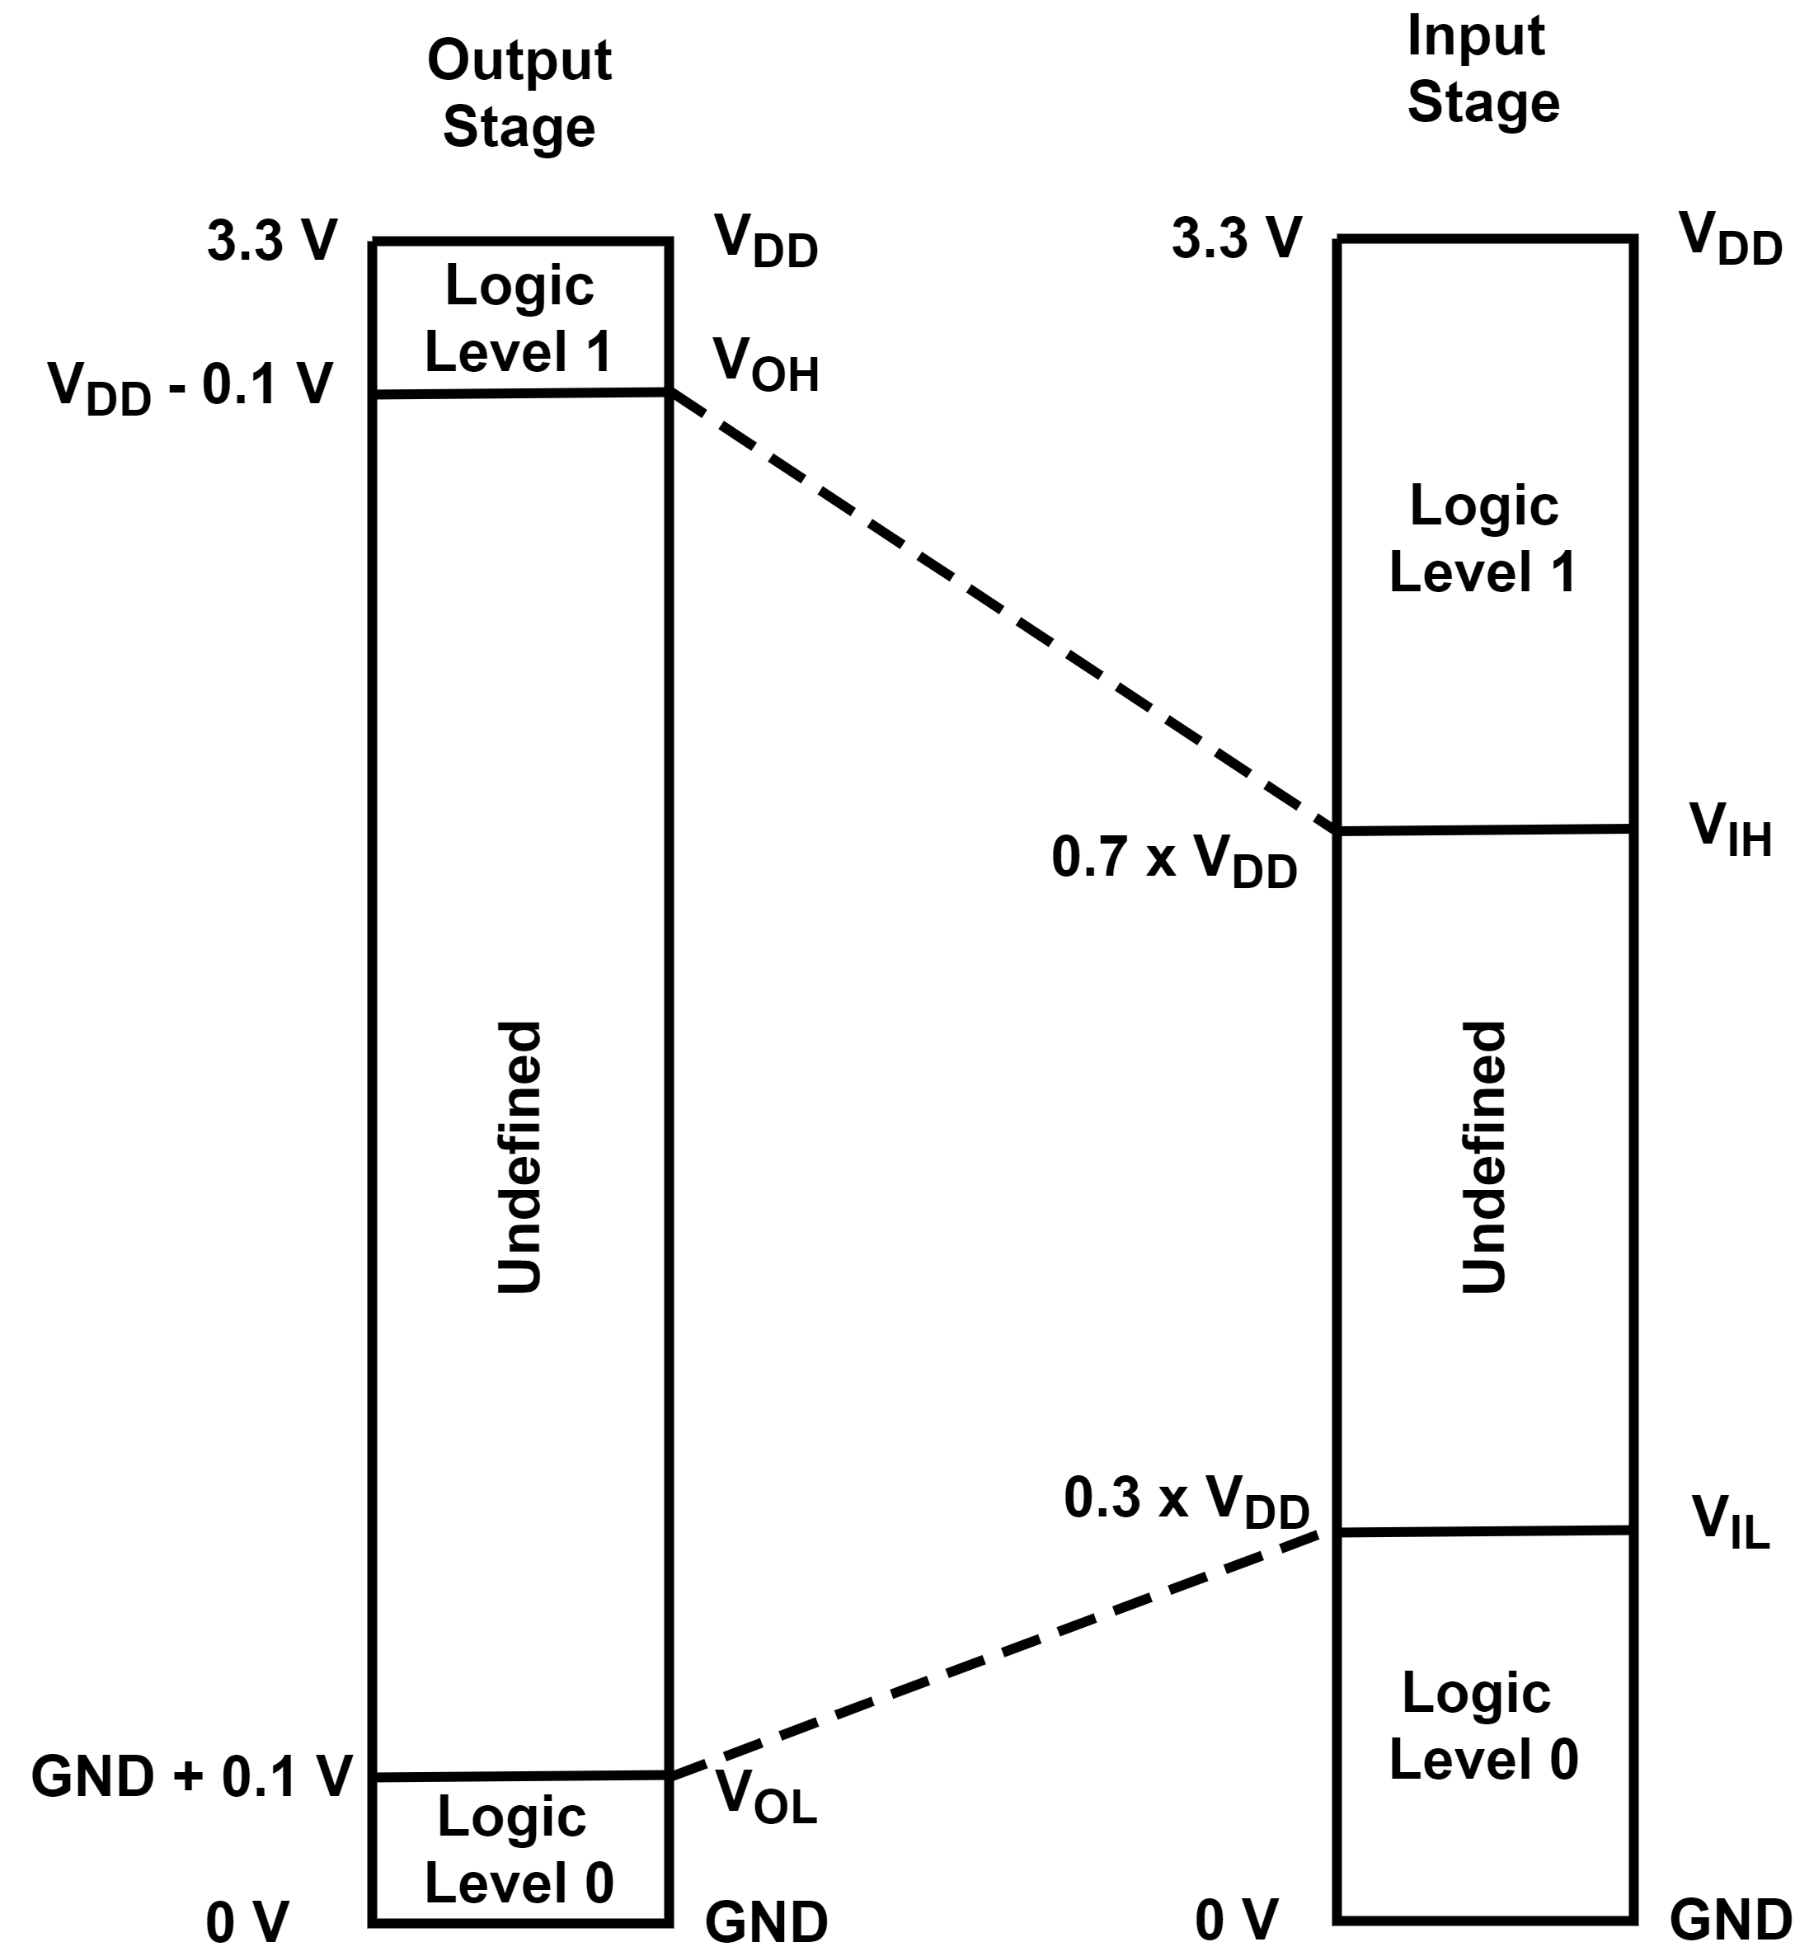
Bit Values as Voltage Levels
LVTTL
LVCMOS
3.3 V logic levels

Slide 7
Interfacing Voltage Levels with the Microcontroller
While using a GPIO pin of the microcontroller, some applications may require special consideration.
  Digital input from a switch or button
  Digital I/O with high voltage values
  Digital output to a load requiring high current and voltage values

Slide 8
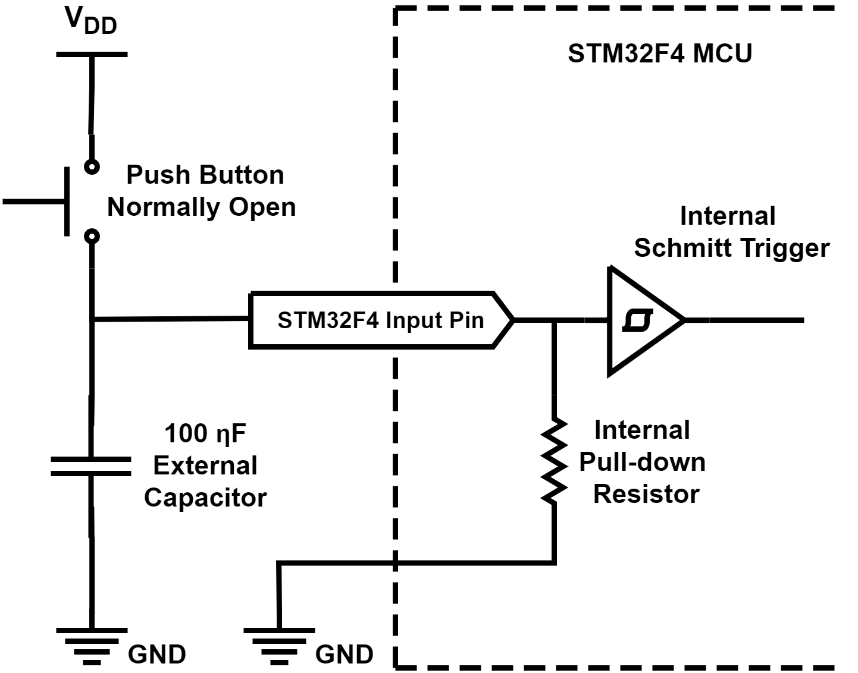
Interfacing Voltage Levels with the Microcontroller
  Digital input from a switch or button
  Switch bouncing is a serious problem when a button (or switch) is used in a digital system.
  Software solutions
    adding a delay while reading the input in the code.
    using a shift register.
  Hardware Solution

Slide 9
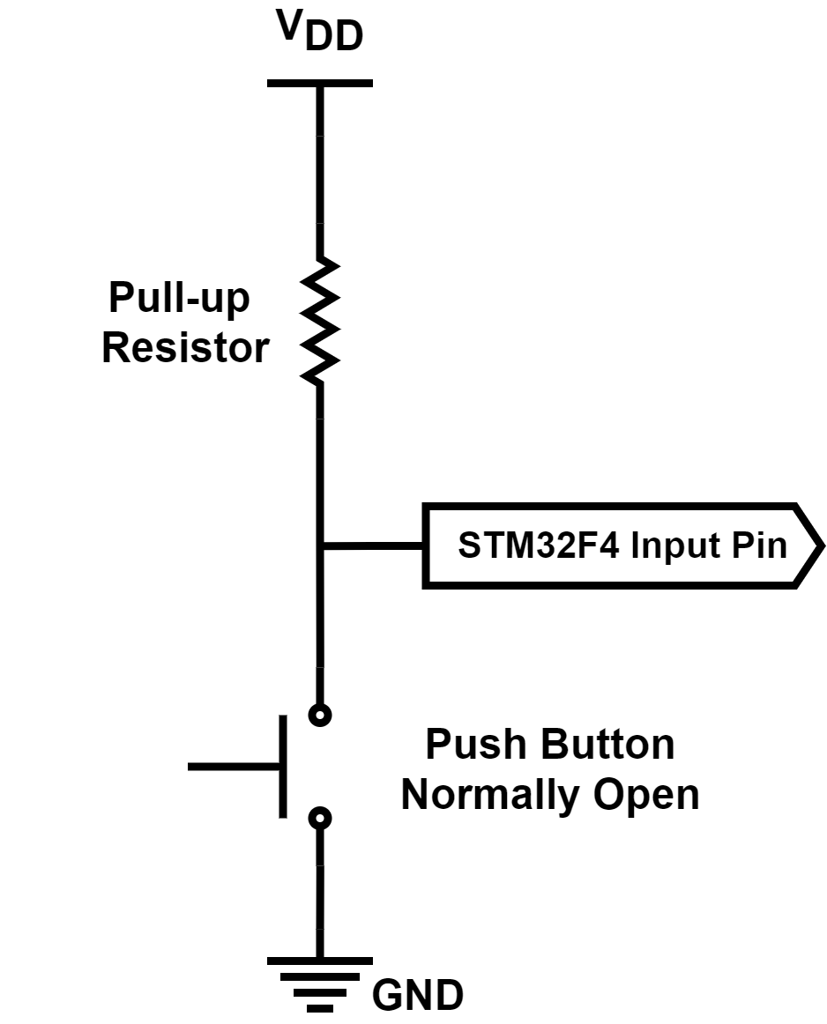
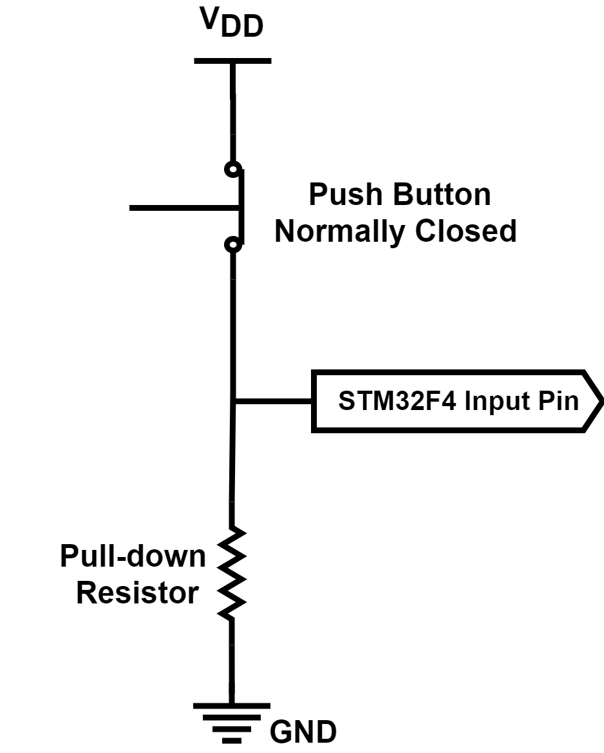
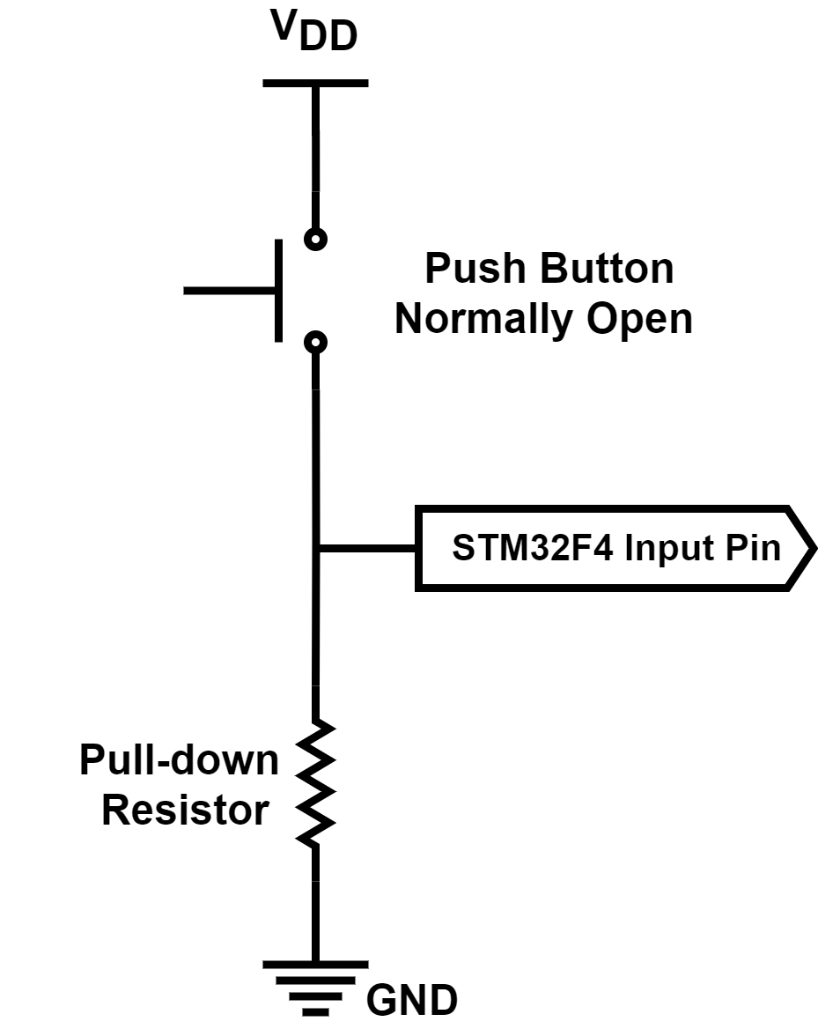
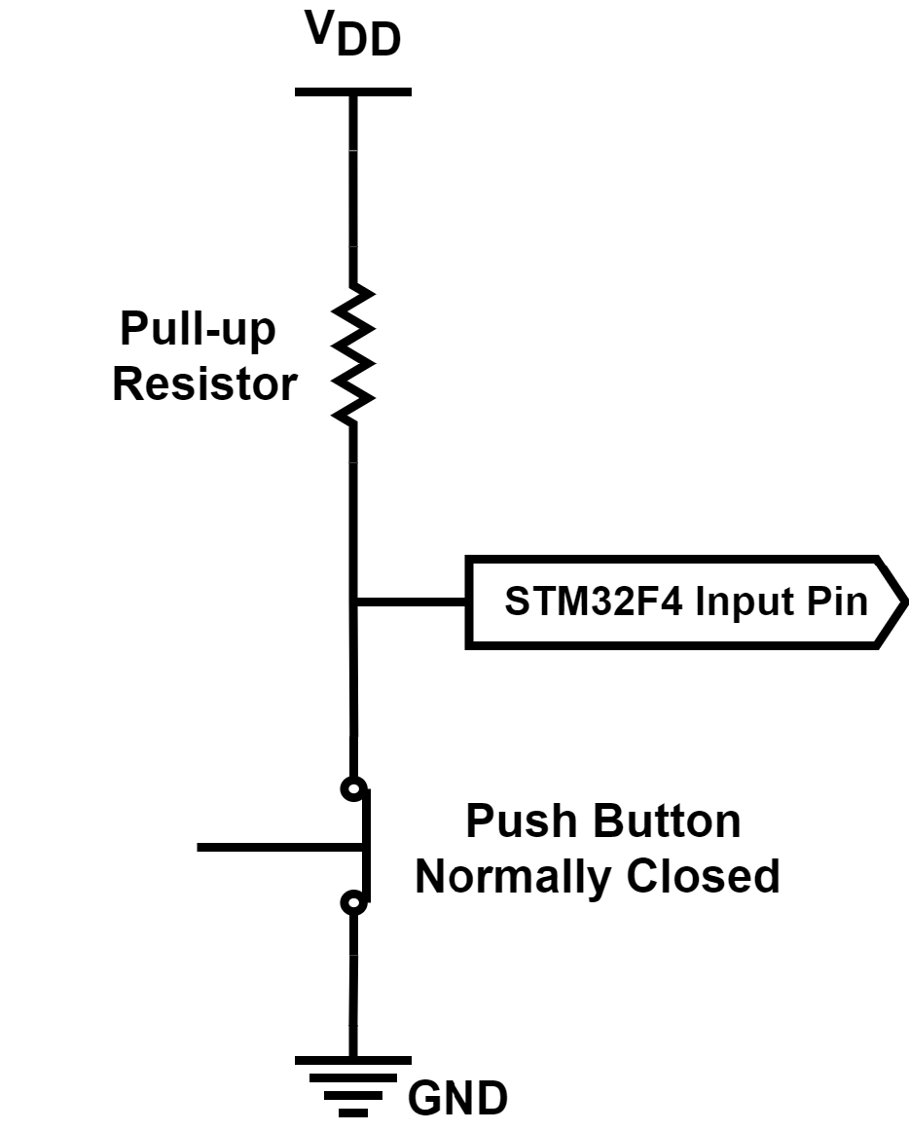
Interfacing Voltage Levels with the Microcontroller
  Digital input from a switch or button
  Active high and low input circuit diagrams for the push button

Slide 10
Interfacing Voltage Levels with the Microcontroller
  Digital I/O with high voltage values
  Digital input to the microcontroller can originate from a source, such as sensor or external device.
  Directly connecting such a source to the microcontroller can damage or burn out the GPIO pin circuitry.
  There are two methods to handle such situations.
    using a level shifter between the high voltage source or load and microcontroller.
    using high voltage tolerant pins of the microcontroller, if there are any.

Slide 11
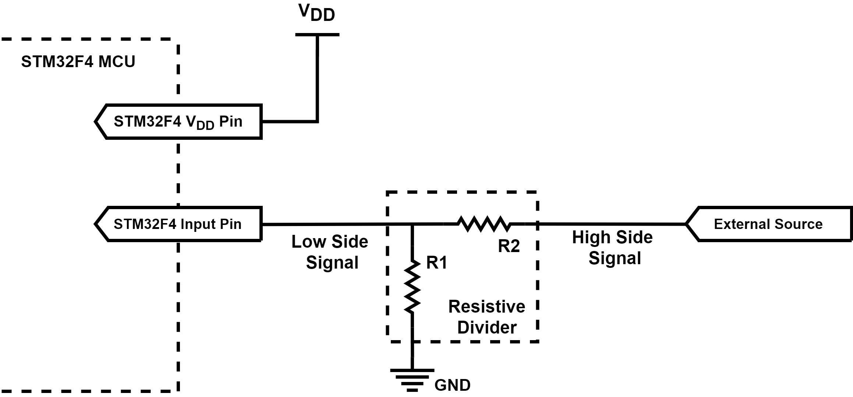
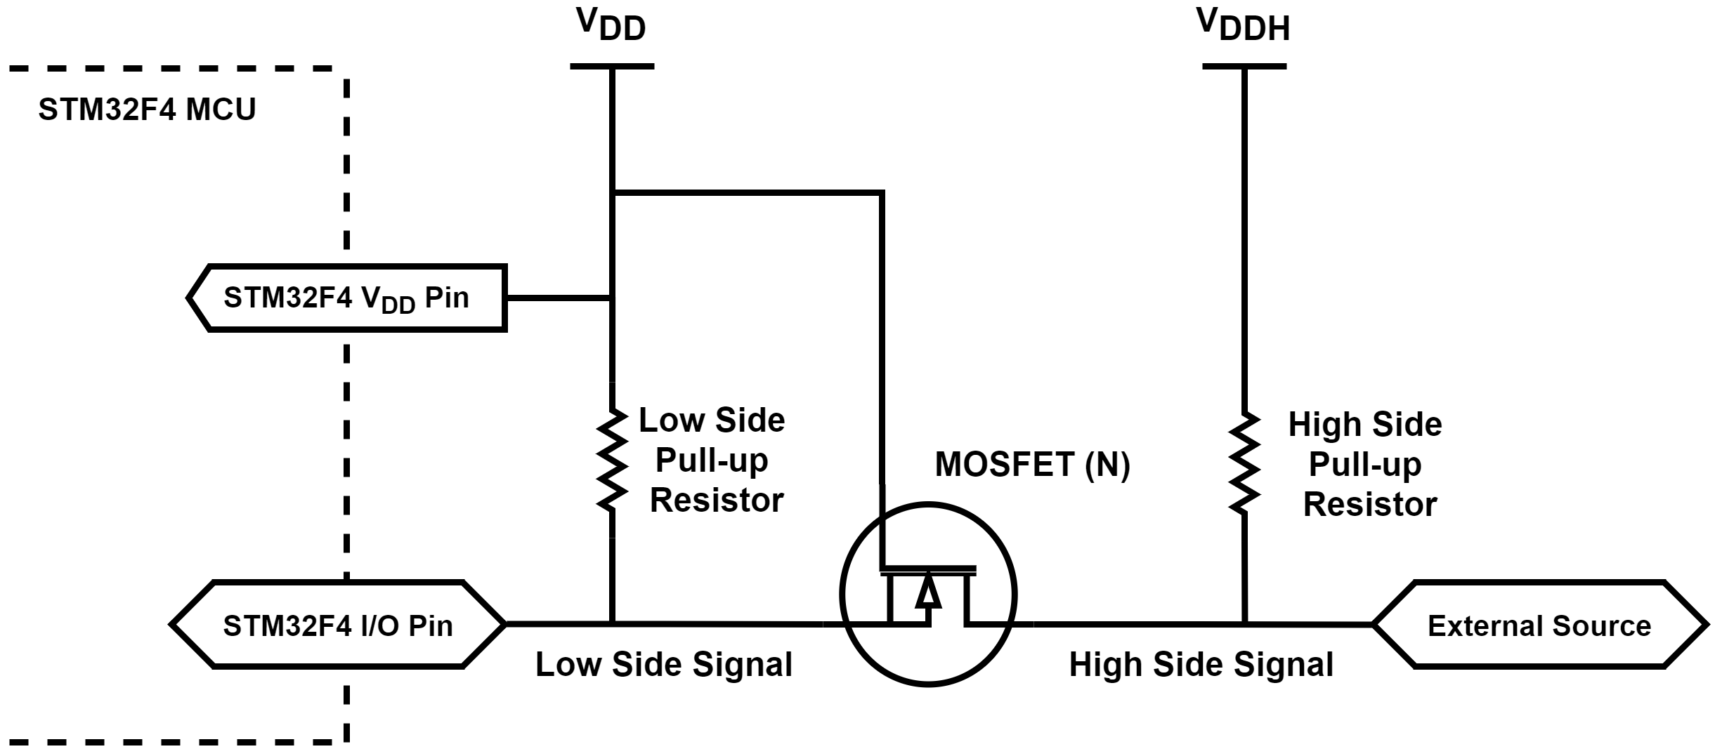
Interfacing Voltage Levels with the Microcontroller
  Basic unidirectional voltage level shifter
  Basic bidirectional voltage level shifter

Slide 12
Interfacing Voltage Levels with the Microcontroller
  Digital output to a load requiring high current and voltage values.
  We may want to drive heavy loads, such as a motor or power LEDs, by the microcontroller.
  Voltage and current output from the microcontroller may not be sufficient for them. There are three methods to handle these cases using
    transistors
    optocouplers
    relays

Slide 13
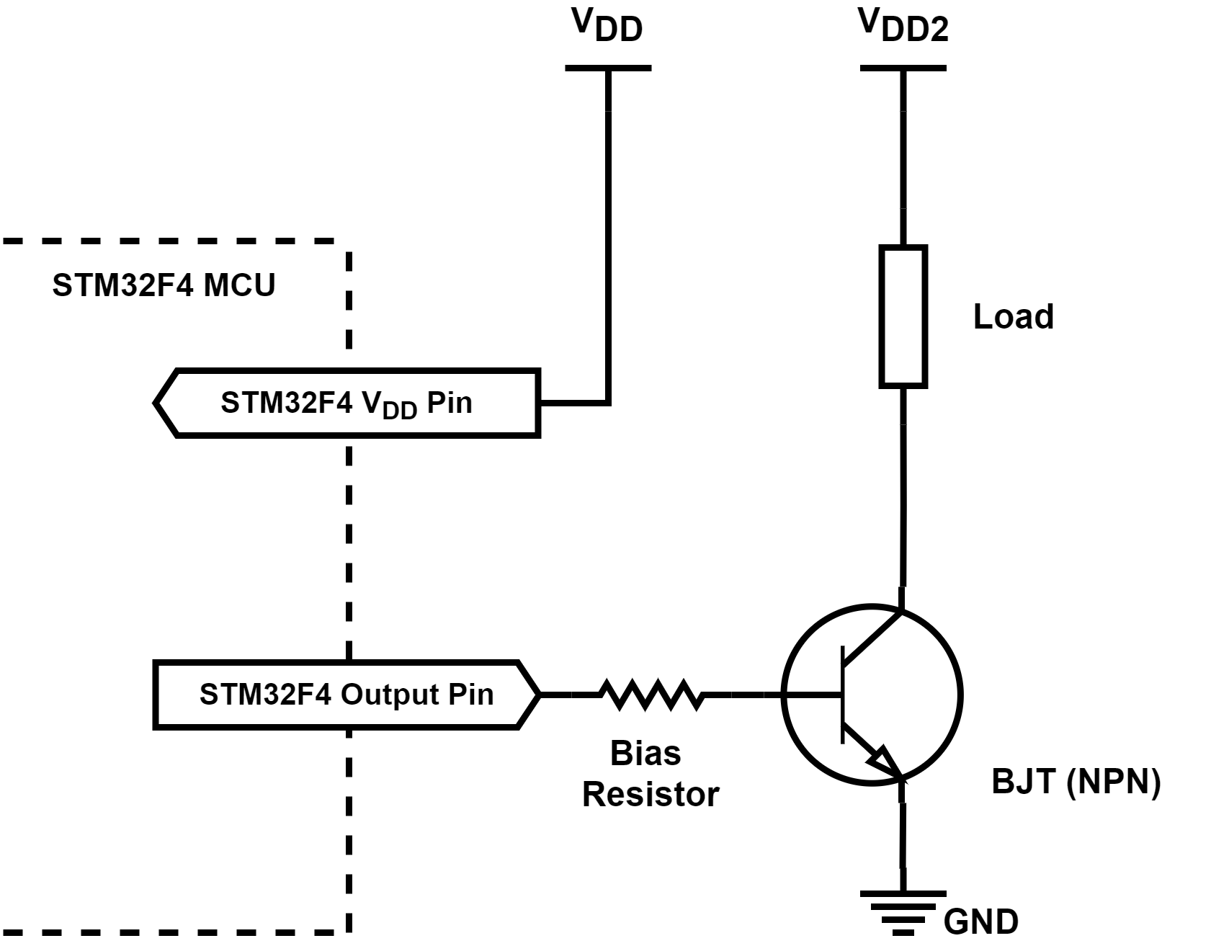
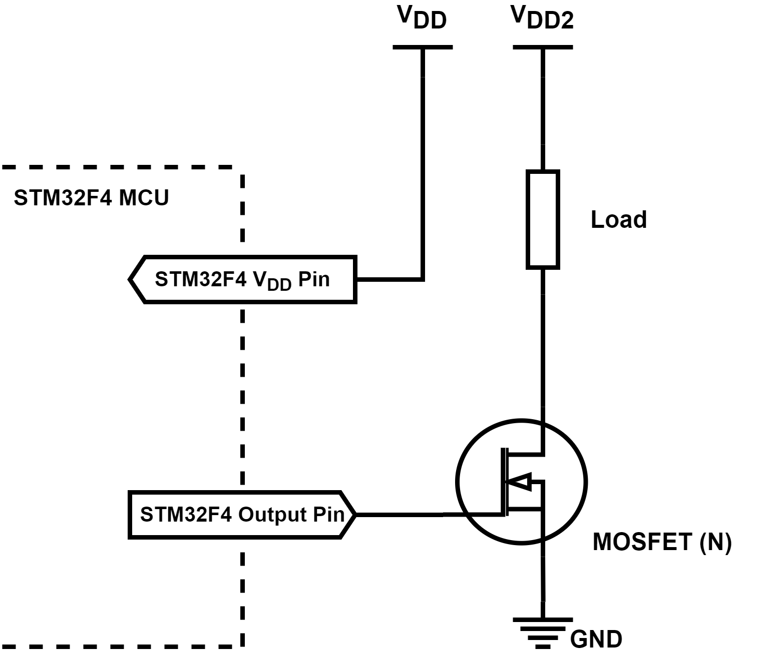
Interfacing Voltage Levels with the Microcontroller
  Driving a heavy load with transistor
BJT
MOSFET

Slide 14
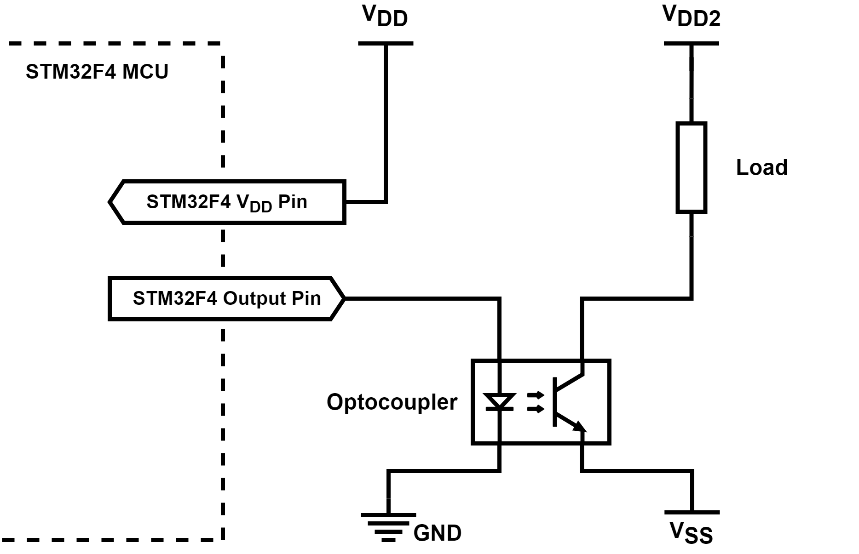
Interfacing Voltage Levels with the Microcontroller
  Optocoupler between the load and microcontroller pin

Slide 15
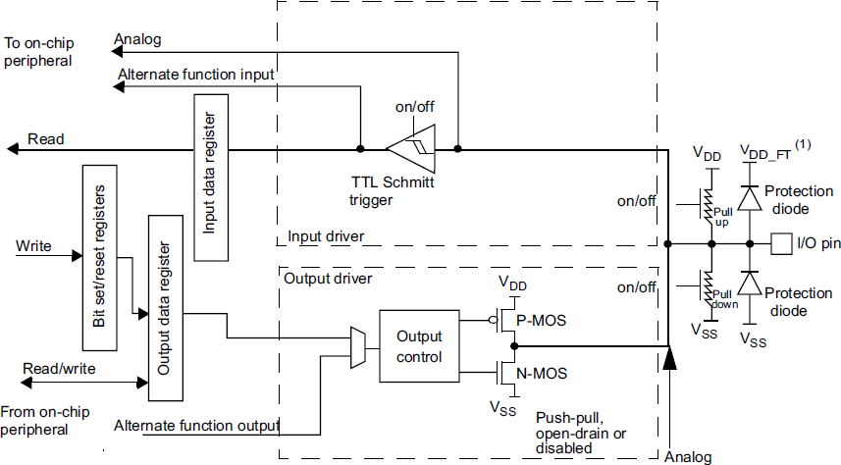
Digital I/O Setup on the STM32F4 Microcontroller
  Circuit diagram of a pin

